Slide 1
Real case implementations using Azure Logic Apps and/or Microsoft Flows
… and PowerApps
Sandro Pereira
MVP | Microsoft Azure (Integration)

Slide 2

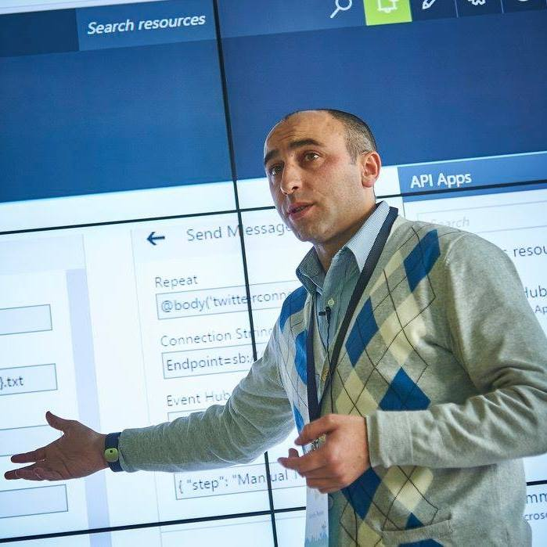


Who am I?
Integration Codeless Wizard
Microsoft Azure MVP
sandro.pereira@devscope.net
linkedin.com/in/sandropereira
@sandro_asp
https://blog.sandro-pereira.com/
Public speaker
Father
Book author: “BizTalk Mapping Patterns and Best Practices”
Sandro Pereira
+351 223 751 350
www.devscope.net
Notes:
Interested in all things integration – which of course includes MS Flow

Slide 3


Slide 4


Slide 5

In a blacksmith house ...
wooden skewer.
Portuguese proverb

Slide 6
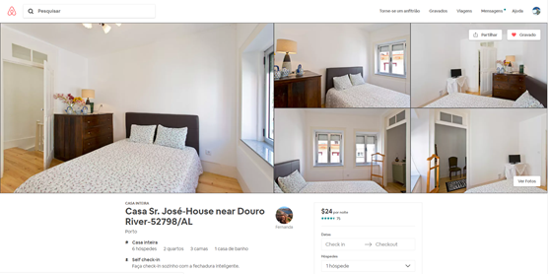
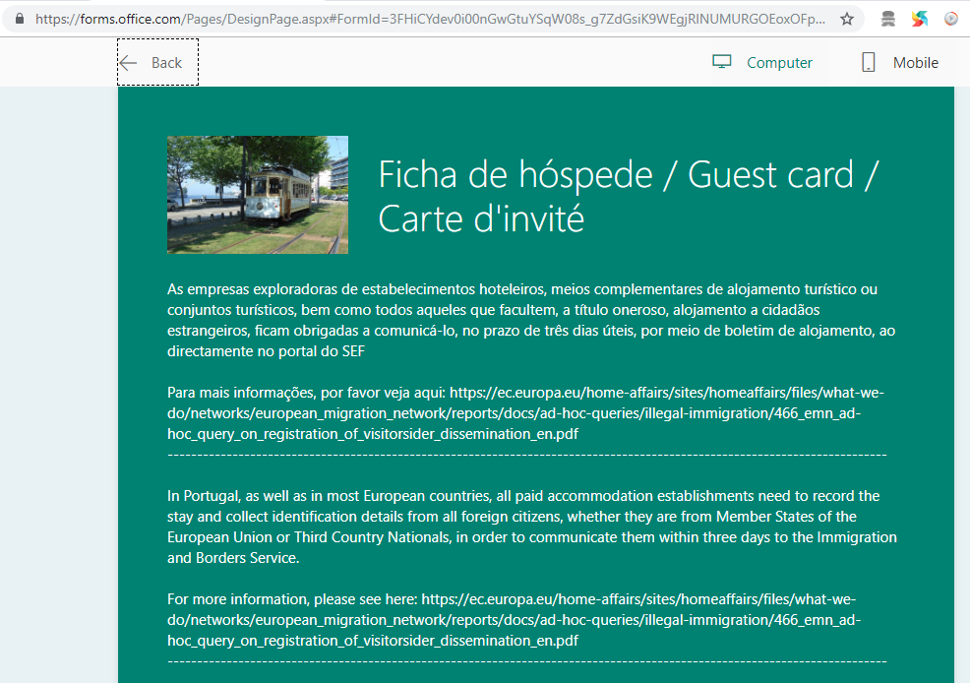

Scenario #1 – My Airbnb host
SEF
(Foreign Service and borders)
https://www.airbnb.pt/rooms/18272087
Microsoft Flow

Slide 7

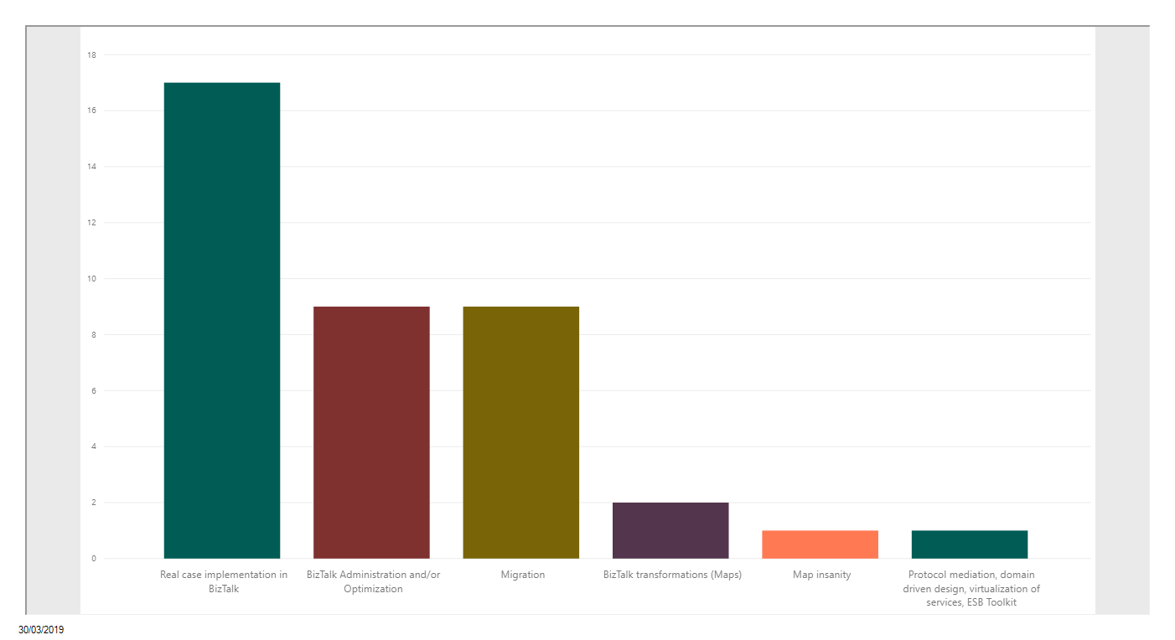
What is the topic you would like to see addressed by me?

Slide 8
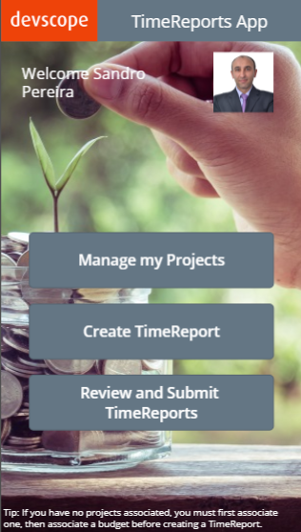
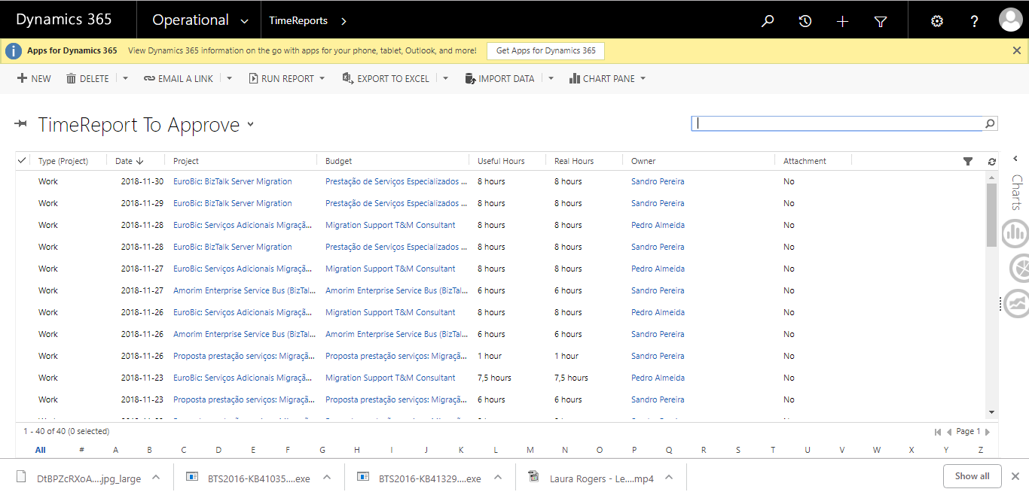
Scenario #2 – Time Reports App
Microsoft Flow
API Management
Web API
Azure SQL Database
ON PREM

Slide 9
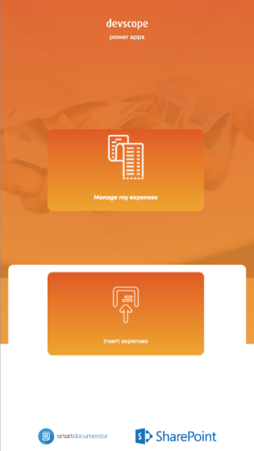
Scenario #3 – SmartDocumentor Expenses
Microsoft Flow
Azure SQL Database
ON PREM
API Management
Web API

Slide 10
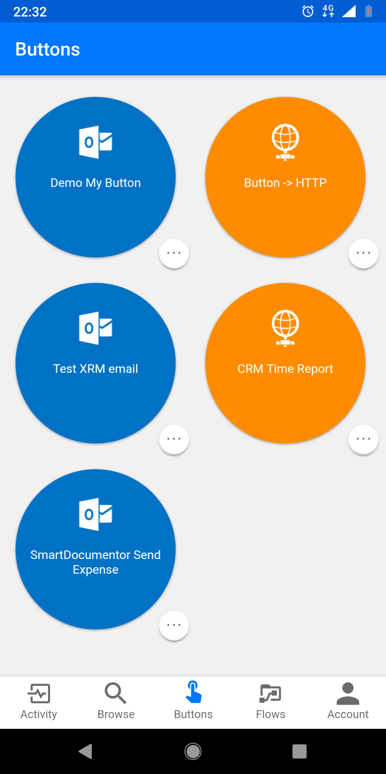
Scenario #4 – SmartDocumentor Expenses II
Logic Apps
ON PREM
Web API

Slide 11
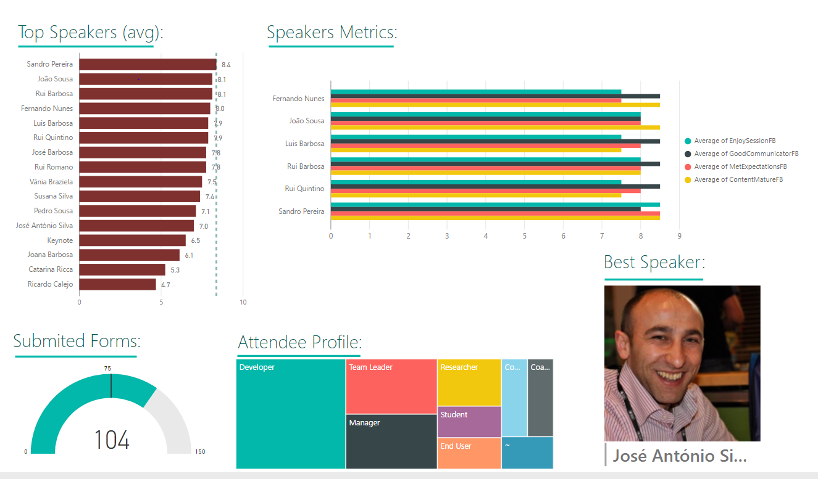
Scenario #5 – SmartDocumentor Evaluation Forms (Paper)
KPI’s
Event Attendees
Microsoft
Flow or Logic Apps
Azure
Functions
Power BI

Slide 12

How this is helping us Expand our business?

Slide 13

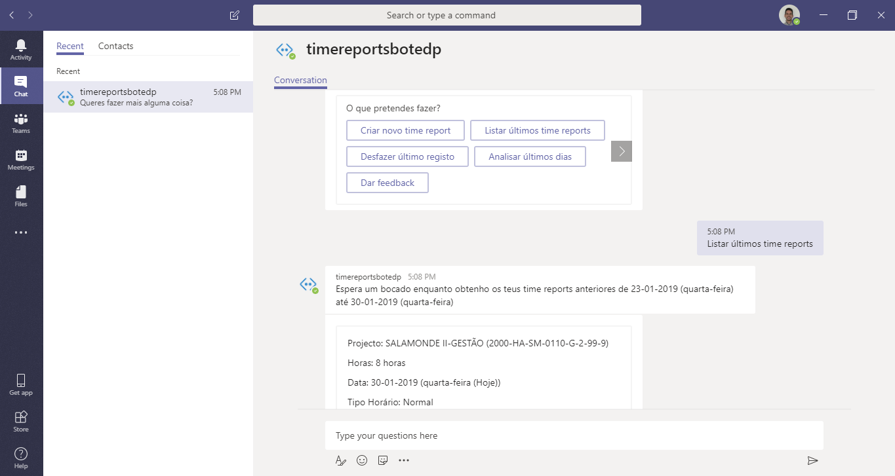

Slide 14
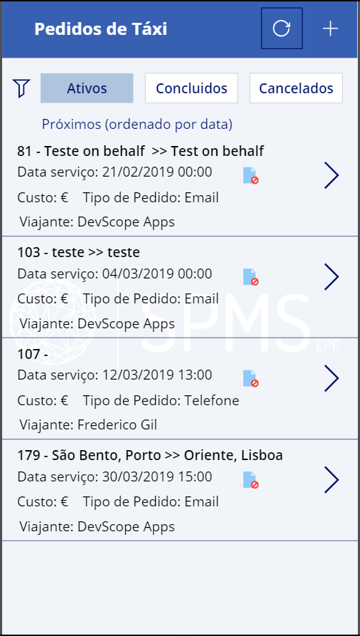
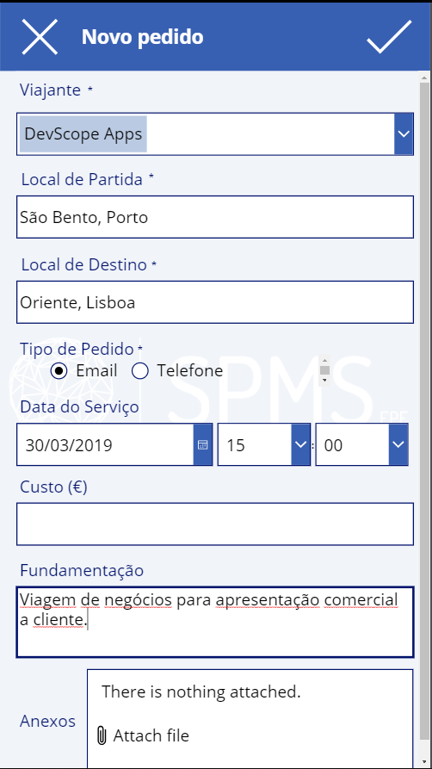
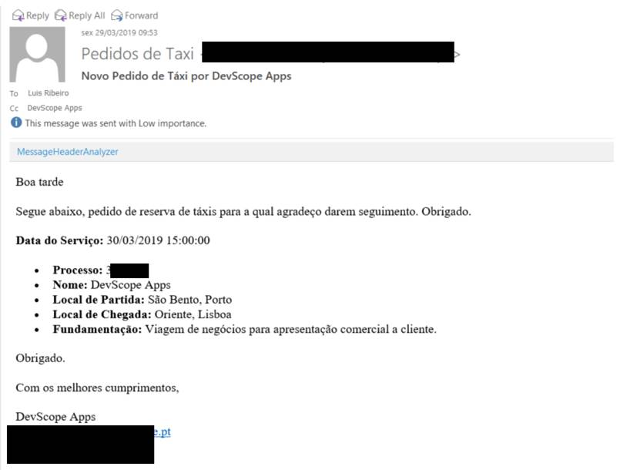
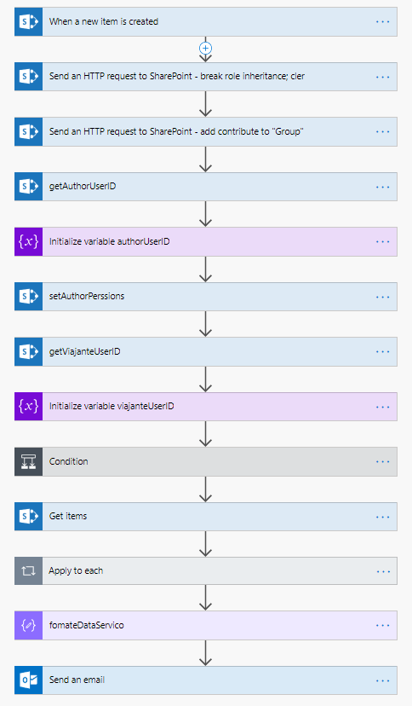
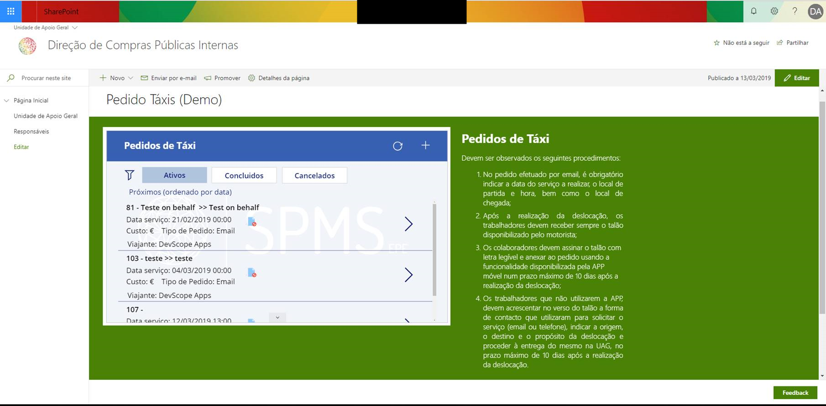
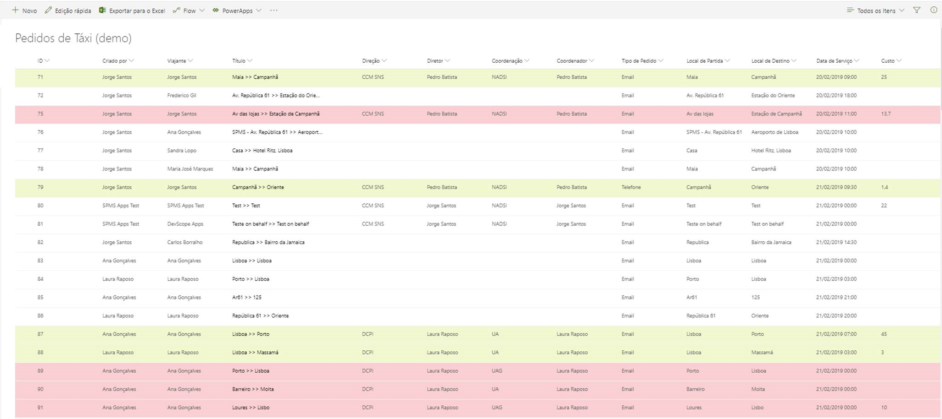

Slide 15





Thanks!
Sandro Pereira
Integration Codeless Wizard | Microsoft Azure & Visio MVP
sandro.pereira@devscope.net
linkedin.com/in/sandropereira
@sandro_asp
https://blog.sandro-pereira.com/
+351 223 751 350
www.devscope.net

